Slide 1
Mission
Develop a prototype Foam Dart Blaster Sentry Gun, capable of identifying targets, actively targeting, and accurately firing at them.
Objectives
Design and create a custom firing mechanism capable of firing foam “Nerf” darts.
Design and create a dynamic mounting system capable of accurately controlling the firing direction.
Develop a bullet counting system with scope to incorporate reloading mechanics if the design permits.
Develop face or object recognition software capable of identifying predefined threats and feeding back data on their location for targeting.
Develop a remotely accessible monitoring and/or control system, e.g. mobile app or hosted website.
Develop an automatic log to capture all important activities, e.g. motion detection, user logon, firing at a target, etc.

Slide 2
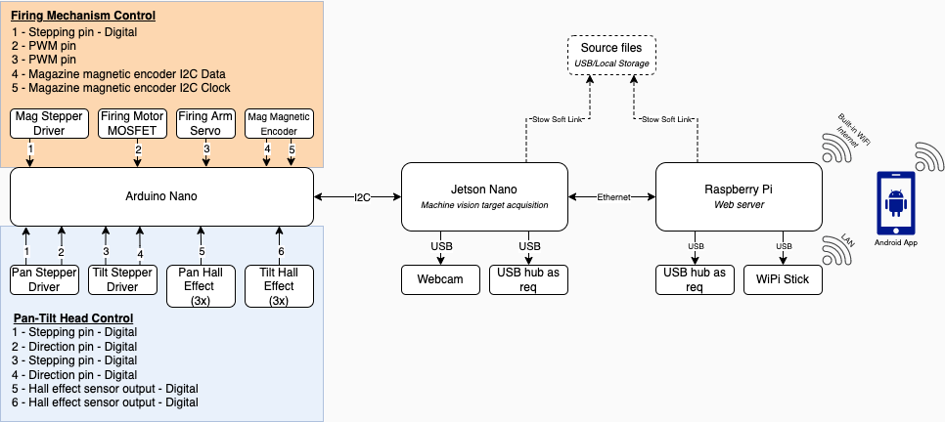
System Overview and Division of Work
Mechatronics |  | Software |  |  |  | Project
Pan and Tilt Mechanism and Circuitry | Firing Mech and Circuitry | Inter-board Comms | Machine Vision | Webserver | Mobile Application | Project Management
Andrew | Chris | Joel and Harshitha | Sian | Josh | Kamyar | Andrew

